Slide 1



Employee Benefits Guide
January 1, 2027 – December 31, 2027

Slide 2
Table of Contents
Topic | Page
Contact Information | 2
Medical/RX Benefits | 3-4
Virtual Care (Telehealth) | 5
Express Scripts Mail Order Pharmacy | 6
SaveonSP | 7
Fitness Reimbursement | 8
myCigna App | 9
Omada | 10-11
Cigna Diabetes and Hypertension (Omada) | 12
Dental Benefits | 13
Cigna Dental Oral Health Integration Program | 14-15
Vision Benefits | 16
Flexible Spending Accounts | 17
Basic Life and AD&D Insurance | 18
Optional Life Insurance | 19
Disability Insurance | 20
Critical Illness | 21
Hospital Indemnity | 22
Accident Insurance | 23-24
Employee Assistance Program | 25
Total Behavioral Health | 26-27
Virtual Vet Care | 28
Additional Benefits | 29
Enrollment & Next Steps | 30-31
Notices | 32
Mobile App | 33
1

Slide 3

Contact Information
Benefits: | Customer Service Number: | Website/Email:
Medical/RX, Dental Cigna | 1-800-244-6224 | www.myCigna.com
Vision Cigna | 1-888-353-2653 | www.myCigna.com
Virtual Care (Telehealth) Cigna | 1-888-726-3171 | www.myCigna.com
Behavioral Health Headspace through Cigna | N/A | www.myCigna.com
Lifestyle Change Program Omada | N/A | https://go.omadahealth.com/coke northeast
Flexible Spending Accounts PayFlex (Inspira Financial) | 1-844-729-3539 | www.inspirafinancial.com
Life/AD&D New York Life | EOI: 1-866-607-2360 Life Claims: 1-800-362-4462 | www.MyNYLGBS.com
Disability New York Life | Claims: 1-888-842-4462 | www.MyNYLGBS.com
Critical Illness, Hospital Indemnity and Accident Insurance Cigna | 1-800-754-3207 | Claims: https://www.cigna.com/individuals-families/member-resources/supplemental-health-claim-form
401K Vanguard | 1-800-523-1188 | www.Vanguard.com
Employee Assistance Program Cigna | 1-877-622-4327 | Website: www.myCigna.com Employer ID: CokeNE (for initial registration)
Leave of Absence New York Life | 1-888-842-4462 | www.MyNYLGBS.com
Virtual Vet Care Airvet | N/A 2 | www.join.airvet.com/getstarted

Slide 4

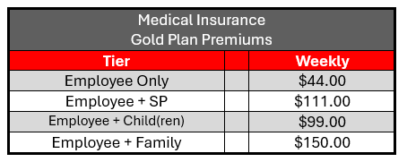
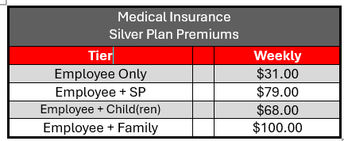
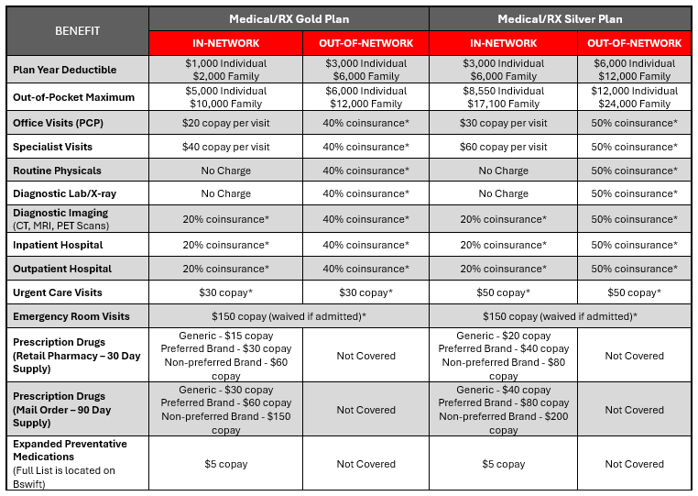
Medical/RX Plans
In 2026, Coca-Cola will continue to offer you and your family the option of enrolling in the Gold Plan or the Silver Plan. As a new hire, benefit coverage begins on the first day of your employment. You have 30 days to complete your new hire enrollment, it is best to complete your enrollment timely to avoid retroactive payroll deductions. Below are the employee contributions and plan summaries:
Out-of-Pocket Maximum | $5,000 Individual | $6,000 Individual | $8,550 Individual | $12,000 Individual
 | $10,000 Family | $12,000 Family | $17,100 Family | $24,000 Family
Office Visits (PCP) | $20 copay per visit | 40% coinsurance* | $30 copay per visit | 50% coinsurance*
Specialist Visits | $40 copay per visit | 40% coinsurance* | $60 copay per visit | 50% coinsurance*
Routine Physicals | No Charge | 40% coinsurance* | No Charge | 50% coinsurance*
Diagnostic Lab/X-ray | No Charge | 40% coinsurance* | No Charge | 50% coinsurance after deductible
Diagnostic Imaging (CT, MRIs, PET Scans) | 20% coinsurance* | 40% coinsurance* | 20% coinsurance* | 50% coinsurance*
Inpatient Hospital | 20% coinsurance* | 40% coinsurance* | 20% coinsurance* | 50% coinsurance*
Outpatient Hospital | 20% coinsurance* | 40% coinsurance* | 20% coinsurance* | 50% coinsurance*
Urgent Care Visits | $30 copay* | $30 copay* | $50 copay* | $50 copay*
Emergency Room Visits | $150 copay (waived if admitted)* |  | $150 copay (waived if admitted)*
Prescription Drugs (Retail Pharmacy - 30 Day Supply) | Generic - $15 copay Preferred Brand - $30 copay Non-Preferred Brand - $60 copay | Not Covered | Generic - $20 copay Preferred Brand- $40 copay Non-Preferred Brand - $80 copay | Not Covered
Prescription Drugs (Mail Order – 90 Day Supply) | Generic - $30 copay Preferred Brand - $60 copay Non-Preferred Brand - $150 copay | Not Covered | Generic - $40 copay Preferred Brand - $80 copay Non-Preferred Brand - $200 copay | Not Covered
Expanded Preventative Medications (Full List is located on Bswift) | $5 Copay | Not Covered | $5 Copay | Not Covered
* Coverage provided after deductible

Slide 5

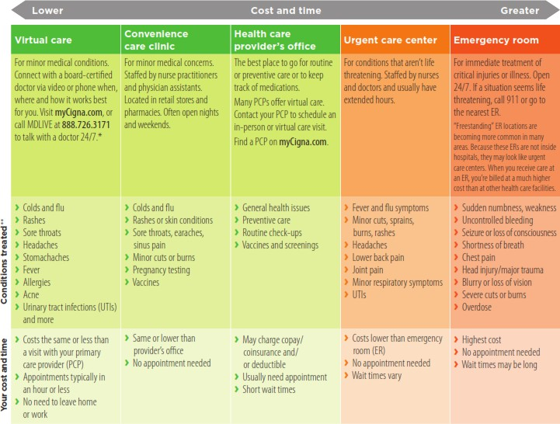
Medical/RX Plans
Cigna Health Information Line
A telephone service staffed by clinicians who help you understand and make informed decisions about health issues you are experiencing, at no extra cost. These clinicians can help you choose the right care in the right setting at the right time, whether it’s reviewing home treatment options, following up on a PCP’s appointment or finding the nearest in-network urgent care center. Just call the number on your Cigna ID card, go to myCigna.com or use the myCigna App. Open 24/7.

Slide 6

Virtual Care (Telehealth)
Telehealth Copay:
Gold Plan: $15 Silver Plan: $20
Life is demanding. It’s not always easy to find time for the health care you need. After all, doctors’ appointments traditionally involve time and travel. That can lead to putting off care until problems become more serious, and potentially more expensive.
That’s why Cigna has partnered with MDLIVE to offer a comprehensive suite of convenient virtual care options
— available by phone or video whenever it works for you. MDLIVE board-certified doctors, dermatologists, psychiatrists and licensed therapists have an average of over 10 years of experience and provide personalized care for hundreds of medical and behavioral health needs.
Now you don’t have to wait – or travel – for the care you need. Connect with video or phone, whenever it’s convenient for you. Best of all, virtual care from MDLIVE board-certified doctors is available to you and your eligible dependents as part of your health benefits.
Primary Care
Preventative care, routine care, and specialist referrals
Behavioral/Mental health care
Talk therapy and psychiatry from the privacy of home
Access to psychiatrists and therapists
Schedule an appointment that works for you
Option to select the same provider for every session
Care for issues such as anxiety, stress, life changes, grief and depression
Dermatology
Fast, customized care for hair skin and nail conditions
– no appointment required
Board-certified dermatologists review pictures and symptoms; prescriptions available, if appropriate
Care for common skin, hair and nail conditions including acne, eczema, psoriasis, rosacea, suspicious spots and more
Diagnosis and customized treatment plan, usually within 24 hours
Preventive care checkups/wellness screenings available at no additional cost to identify conditions early
Routine care visits allow you to build a relationship
with the same primary care provider (PCP) to help manage conditions
Prescriptions available through home delivery or at local pharmacies, if appropriate
Receive orders for biometrics, blood work and screenings at local facilities
Urgent Care
On demand care for minor medical conditions
On-demand 24/7/365, including holidays
Care for hundreds of minor medical conditions
A convenient and affordable alternative to urgent care centers and the emergency room
Prescriptions available, if appropriate
Connect with virtual care your way.
Virtual care visits are convenient and easy. To schedule an appointment:
Talk to an MDLIVE medical provider on demand on myCigna.com. You can also call 24/7 at 888- 726-3171
Select the type of care you need – cost will be displayed
Follow the prompts for your desired type of visit
MDLIVE providers can also conduct virtual wellness screenings.
Appointments available via video or phone. Virtual dermatology does not require an appointment.

Slide 7

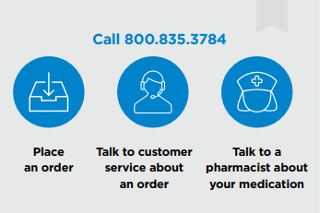
Express Scripts
Express Scripts® Pharmacy, Cigna’s home delivery pharmacy, is a convenient option if you’re taking a medication on a regular basis to treat an ongoing health condition. Express Scripts® Pharmacy is one of the country’s largest home delivery pharmacies.
What are the benefits of using Express Scripts pharmacy?
Express Scripts Pharmacy helps it make it easy for you to get your medication. With just a few simple clicks of your mobile phone, tablet or computer, your important medications will be on their way to your door (or location of your choice).
Easily order, manage, track, and pay for your medications on your phone or online.
Standard shipping at no extra cost?
Fill up to a 90-day supply at one time
Helpful pharmacists available 24/7
Automatic refills and refill reminders so you don’t miss a dose
Flexible payment options
3 easy ways to switch to home delivery
Log in to the myCigna App or myCigna.com to move your prescription electronically. Click on the Prescriptions tab and select My Medications from the dropdown menu. Then simply click the button next to your medication name to move your prescription(s).
Call your doctors office. Ask them to send a
90-day prescription (with refills) electronically to
Express Scripts Home Delivery, Or,
Call Express Scripts Pharmacy at 800.835.3784. They’ll contact your doctor’s office to help transfer your prescription. Have your Cigna ID card, doctor’s contact information and medication name(s) ready when you call.
Got a new prescription?
Ask your doctor to send it to Express Scripts Pharmacy using one of these methods:
Electronically: For fastest service, they can send your prescription electronically to Express Scripts Home Delivery, NCPDP 2623735
By fax: They can call 888-327-9791 to get a Fax Order Form.

Slide 8

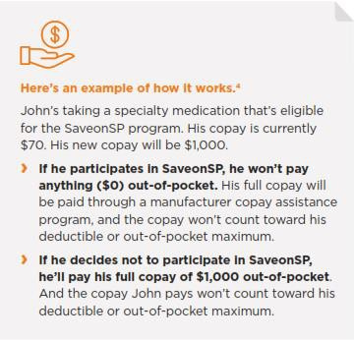
SaveonSP
Specialty medications can cost a lot of money. That’s why your plan offers a program called SaveonSP, which can help lower your out-of-pocket costs to $0. And there’s no extra cost to participate.
Enroll in SaveonSP and save.
Certain specialty medication are eligible for the SaveonSP program. If you’re filling an eligible
medication, a representative from SaveonSP will call you to talk about enrolling in the program.
If you choose to participate, you’ll pay $0 for your medication. If you choose not to participate in
SaveonSP, you’ll pay a higher copay when you fill your medication.
Conditions supported by SaveonSP include, but are not limited to:
Hepatitis C
Multiple Sclerosis
Psoriasis
Inflammatory Bowel Disease
Rheumatoid Arthritis
Oncology
SaveonSP is an Express Scripts program, and Express Scripts is now a Cigna company. SaveonSP, Express Scripts and Cigna are working together to better serve you and all of your pharmacy, health and wellness needs.
The drug classes, medications and associated copays included in this program are subject to change. Check your plan materials to see which medications are eligible for the SaveonSP program.

Slide 9


Fitness Reimbursement
As a customer of the Cigna Medical Plan and an employee of Coca-Cola Beverages Northeast, you are eligible for a fitness reimbursement. The maximum fitness benefit is $500 per calendar year per medical plan participant. Each member of your family qualifies if they are Cigna members.
What kind of health club membership or fitness class may qualify?
Start exercising your option by picking a qualified full-service health club that works for you. The facility you choose must have a vast array of cardiovascular and strength-training exercise equipment, such as traditional health clubs and YMCAs. You may also attend fitness classes at a qualified health club or studio without an annual membership. Online fitness subscriptions such as Peloton and Mirror are also eligible for reimbursement.
What health clubs do not qualify?
Martial arts centers;
Gymnastic facilities;
Country clubs;
Tennis;
Pool-only facilities;
Social clubs;
Sports teams and leagues;
**Fees for personal training, lessons, coaching and exercise equipment or clothing purchases will not be covered.**
What you need to do:
At the time of reimbursement submission, the Cigna customer must be a current Coca-Cola Beverages Northeast employee and be a customer of the Cigna Medical Plan to be eligible for this reimbursement.
Reimbursement is based on your total receipts up to $500 per calendar year per medical plan participant. Reimbursement requests and receipts must be completed and submitted no later than March 31st of the following calendar year.
      How to submit for reimbursement:
          Download the IncentFit app or visit https://app.incentfit.com/login. Set up an account with IncentFit, including direct deposit information. Take a photo of your receipt with your phone and upload it to the IncentFit app or website. The photo should include your name, the facility name and amount paid. You will be asked to confirm a few short questions and submit.
        Processing should take less than a week.
        Reimbursement is based on your total receipts up to $500 per calendar year per medical plan participant.
        Claims must be submitted no later than March 31st of the following calendar year.
        At the time of reimbursement submission, you must be a current Coca-Cola Beverages Northeast employee and be a customer of the Cigna Medical Plan to be eligible.

Slide 10



myCigna App
Now it’s easier than ever to manage your health and make the most of your health plan on the myCigna® website and app. From programs that help improve your health to tools that help manage your health spending, there’s so much you can do.
View, print, and send ID cards*
Find in-network doctors, hospitals, and medical services
Compare quality of care information, including patient reviews from Cigna customers
Manage and track claims
See cost estimates for medical procedures
Use the click chat feature to connect with a live Cigna rep
Feel better protected
Cigna is as committed to helping protect your health information
as we are to protecting your health and well-being. That’s why we take certain steps to enhance the
security of your personal health information on myCigna.
Register Today:
Go to myCigna.com or launch the
myCigna app and select “Register Now”
Enter your requested information
Confirm your identity
Create your security information and provide your primary email address
Review and Submit
Feel better protected:
Cigna is as committed to helping protect your health information as we are to protecting your health and well-being. That’s why we take certain steps to enhance the security of your personal health information on the myCigna website and app.
Enhanced registration
Two-step authentication
*Continuing in 2027, Digital ID cards via the myCigna app will take place of physical ID cards. If you’d still like a physical ID card, please reach out to Cigna member services.

Slide 11
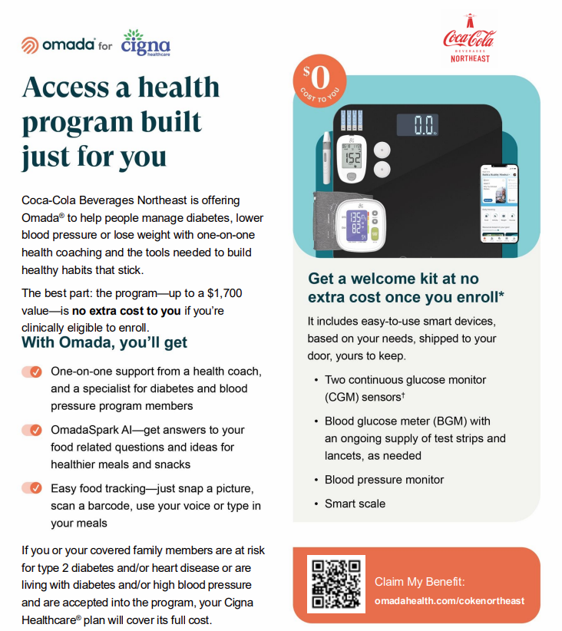
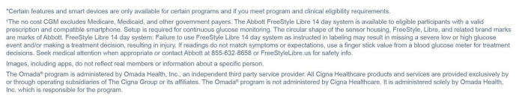
Omada

Slide 12

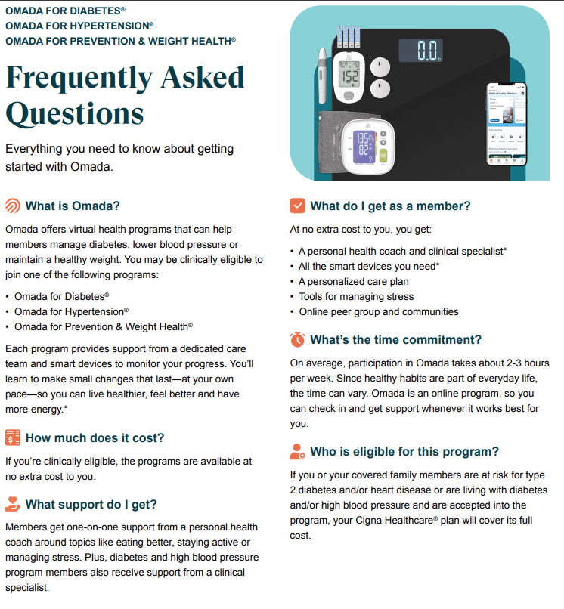

Omada

Slide 13
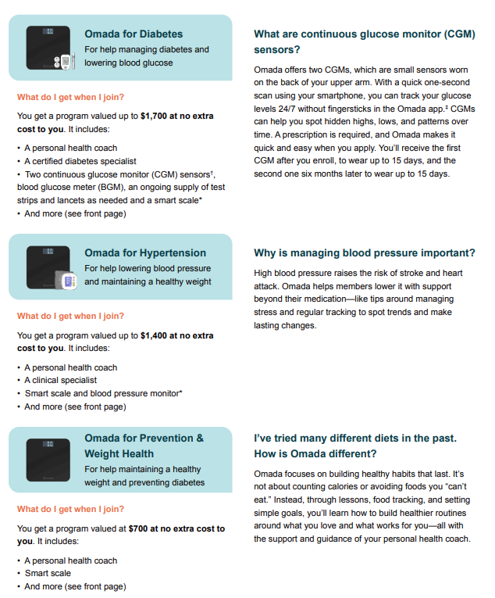
Omada

Slide 14
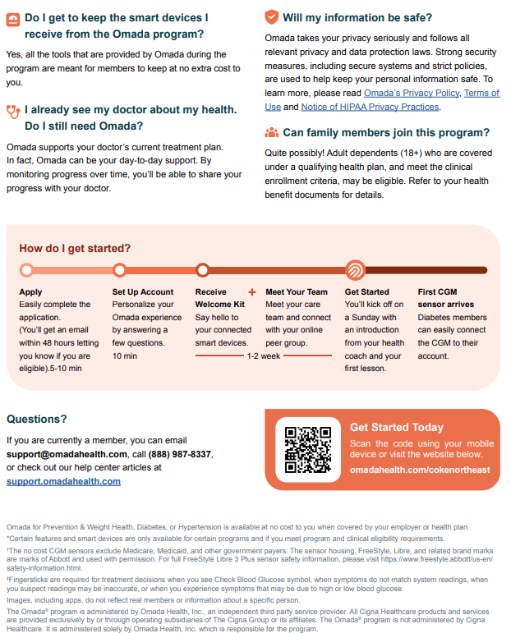
Omada

Slide 15

Dental Benefits
All eligible Coca-Cola employees who work at least 30 hours per week are offered a dental plan through Cigna. When you are enrolled in one of the medical plans, you are automatically enrolled in the dental plan at no additional cost.
Benefit | In-Network | Out-of-Network*
Your Coverage with a Cigna Provider
Calendar Year Deductible Individual Family | $60 $120 | $60 $120
Calendar Year Maximum | $1,500 | $1,500
Class I – Diagnostic & Preventative (Bitewing X-Rays, Full Mouth X-Rays, Cleaning, Oral Exams, Sealants) | No charge | No charge
Class II – Basic Restorative (Fillings, Scaling & Root Planning, Simple Extraction) | 10% after deductible | 10% after deductible
Class III – Major Restorative (General Anesthesia, Dentures, Single Crowns) | 40% after deductible | 40% after deductible
Class IV – Orthodontia Coverage for Employee and All Dependents Lifetime Benefits Maximum: $1,500 | 40% after deductible | 40% after deductible
Class IX – Implants | 40% after deductible | 40% after deductible
**For services provided by a non-network dentist, Cigna Dental will reimburse according to the Maximum Reimbursable Charge. The MRC is calculated at the 90th percentile of all provider charges in the geographic area. The dentist may balance bill up to their usual fees.

Slide 16

Cigna Dental Oral Health Integration Program
Get the dental services you need for your medical condition. Enroll in the Cigna Dental Oral Health Integration Program today.
What is the Cigna Dental Oral Health Integration Program?
It’s a program that reimburses out-of-pocket costs for specific dental services used to treat gum disease and tooth decay. The program is for people with certain medical conditions that have been found to be associated with gum disease and cavities. There’s no additional cost for the program – if you qualify, you get reimbursed!
How does it work?
When you visit your dentist, you will pay your usual out-of-pocket costs (deductible, copay or coinsurance amount). As a reminder, your copay is the fixed amount you pay for covered services, and your coinsurance is the percentage of costs you pay for covered services. Next, your dentist will send Cigna a claim. We review the claim and will refund your out-of-pocket costs for eligible dental services. Once we receive your claim, you can expect to be reimbursed in about 30 days. You must enroll in this program prior to receiving treatment to be eligible for reimbursement.
Do I Qualify?
If you have a Cigna dental plan, you’re eligible for the program. You do NOT have to be enrolled in a Cigna medical plan to be eligible for this program. You must currently be under treatment by a doctor for any of the following conditions:
Heart disease
Stroke
Diabetes
Maternity
Chronic kidney disease
Organ transplants
Head and neck cancer radiation
What else does the Oral Health Integration Program Include?
When you join the program, you get discounts on prescribed mouthwashes, fluoride gels, and toothpastes from your dentist through Cigna Home Delivery Pharmacy who will help you get these items sent right to your home.
You can ask us for information on the issue that affect your oral health and your overall wellness – such as fear of going to the dentist. Or the impact of stress or tobacco products. We’ll also give you guidance on how to overcome these behaviors.

Slide 17
Cigna Dental Oral Health Integration Program
What dental services are covered under the Cigna Dental Oral Health Integration Program?
Check the chart below to see which dental services are covered for each qualifying medical condition.
Medical Conditions (check mark indicates covered dental service¹).
Dental Services | Heart Disease | Stroke | Diabetes | Maternity | Chronic Kidney Disease | Organ Transplants | Head and neck cancer radiation
Periodontal Treatment & Maintenance (D4341, D4342, D4910²) | ✓ | ✓ | ✓ | ✓ | ✓ | ✓ | ✓
Periodontal Evaluation (D0180) |  |  |  | ✓
Oral Evaluation (D0120³, D0140³, D0150³) |  |  |  | ✓
Cleaning (D1110⁴) |  |  |  | ✓
Scaling in the presence of inflammation – Full Mouth (D4346⁴) |  |  |  | ✓
Emergency Palliative Treatment (D9110⁵) |  |  |  | ✓
Topical application of fluoride & Topical application of fluoride varnish (D1206⁶) |  |  |  |  | ✓ | ✓ | ✓
Topical application of fluoride – excluding varnish (D1208⁶) |  |  |  |  | ✓ | ✓ | ✓
Sealants (D1351⁶) |  |  |  |  | ✓ | ✓ | ✓
Sealant Repair – per tooth (D1353⁶) |  |  |  |  | ✓ | ✓ | ✓
Eligibility, reimbursement and coverage for eligible 4. One additional cleaning. services are subject to plan year maximums. 5. No limitations. Four times per year subject to plan guidelines. 6. Age limits removed; all other limitations (including One additional evaluation. frequency limitations) apply.
What are Periodontal Treatment and Maintenance? Periodontal treatment and maintenance are not the same as prophylaxis or “regular cleaning.” Periodontal treatment (or “scaling and root planning”) consists of “deep cleaning” which involves parts of your teeth below the “gum line.” During scaling and root planning the dentist may numb the area of your mouth that she/he is working on. Periodontal maintenance is a follow-up procedure involving removal of plaque and calculus (tartar) above and below the gum line along with scaling and root planning in areas where needed.
How do I enroll?
You must fill out the online registration form found on www.myCigna.com . You can also call the number on the back of your ID card to have an enrollment form sent to you. You only need to complete the form one time per qualifying condition.
Once you’re logged in on www.myCigna.com
, click “Review my Coverage” then select “Dental” from the drop-down menu. Next, from the “Related Links” section on the right side of the page, select “Cigna Dental Oral Health Integration Program Registration Form.” Fill out the form and click “Submit.”
Visit your dentist and pay your usual out-of-pocket cost for the covered service. We’ll send your reimbursement.
To learn more, call Cigna 24/7/365
at 800-Cigna24.
16

Slide 18


Vision Benefits
All Coca-Cola employees who work at least 30 hours per week are offered a vision plan through Cigna.
When you are enrolled in on the medical plans, you are automatically enrolled in vision plan at no additional cost.
Benefit | In-Network | Out-of-Network* | Frequency Period
Your Coverage with a Cigna Provider
Exam Copay | $0 | N/A | 12 months
Exam Allowance (once per frequency period) | Covered 100% | Up to $45 | 12 months
Materials Copay | $10 | N/A | 12 months
Eyeglass Lenses Allowances: (one pair per frequency period)
Single Vision Lined Bifocal Lined Trifocal Lenticular | Covered 100% after Copay Covered 100% after Copay Covered 100% after Copay Covered 100% after Copay | Up to $40 Up to $65 Up to $75 Up to $100 | 12 months 12 months 12 months 12 months
Contact Lenses Allowances: (one pair or single purchase per frequency period)
Elective Therapeutic | Up to $140 Covered 100% | Up to $125 Up to $250 | 12 months 12 months
Frame Retail Allowance (one per frequency period) | Up to $140 | Up to $91 | 24 months
**Your Frequency Period begins on January 1 (Calendar year basis).
Finding a Doctor:
You can find an in-network provider of your choice by visiting www.Cigna.com using the provider locator. Search for a new provider using the following steps:
Cigna.com > Find a doctor > Employer or School > Additional Directories > Cigna Vision Directory (Serviced by EyeMed)
You can search for in-network vision care providers by location or by name. Results include languages spoken, office location, office hours, services provided, brands of designer frames sold, and more. You can even make an appointment online with providers who offer this service.
Have Questions?
Visit www.myCigna.com to review your plan information or call
1-888-353-2653 if you need help to search for a provider.

Slide 19



Flexible Spending Accounts
Coca-Cola offers you the choice of participating in a Health Care Flexible Spending Account and/or a Dependent Care Flexible Spending Account administered by PayFlex (Inspira Financial). These accounts allow you to set aside pre-tax dollars from each paycheck to help pay for out-of-pocket eligible health care and dependent care expenses for you and your family.
Eligible Expenses
Health Care Flexible Spending Account:
+ Copays, deductibles, coinsurance;
+ Eligible medical services or supplies not
covered by your medical plan;
+ Prescription drugs and medicines (copays, coinsurance, etc.);
+ Prosthetic, orthopedic and orthotic devices;
+ Counseling for learning disabilities and psychotherapy expenses to treat specific conditions;
+ Eligible dental services not covered by your dental plan, including orthodontia;
+ Hearing aids and exams not covered by your medical plan; and
+ Smoking cessation programs.
Dependent Care Flexible Spending Account:
+ Qualified day care center ;
+ Nursery school expenses;
+ Before and after school childcare; and
+ Certain types of expenses related to elder care.
Health Care (HCFSA)
The Health Care Flexible Spending Account (HCFSA) allows you to use pre-tax dollars to pay for your out-of-pocket eligible health care expenses for you and your family members. Eligible family members include any person you claim as a dependent for income tax purposes. You can set up a HCFSA regardless of whether you or your dependents have enrolled in a health plan offered by the company.
You can contribute up to a maximum of $3,400 per year into your HCFSA via pretax payroll deductions.
In addition, you will be eligible to carryover amounts left in your Health Flexible Spending Account, up to $680.
This means that amounts you do not use during a Plan Year can be carried over to the next Plan Year and used for expenses incurred in the next Plan Year.
Dependent Care (DCFSA)
The Dependent Care Flexible Spending Account (DCFSA) allows you to use your pre-tax dollars to pay for eligible dependent care expenses, such as day care for your child or care for an older family member.
You can contribute up to a maximum of $7,500 per year per household into your DCFSA (unless you and your spouse file separate tax returns, then the maximum you can contribute is $3,750 per year).

Slide 20



Basic Life & AD&D Benefits
All eligible Coca-Cola employees who work at least 30 hours per week are provided company-paid life insurance and accidental death and dismemberment (AD&D) insurance through Lincoln Financial Group. These benefits are non-contributory, which means Coca-Cola pays 100% of the cost.
COVERAGE | Basic Life and AD&D Benefits
Eligibility | All active, full-time Employees
Life Benefit | 2x your Annual Earnings rounded to the next higher multiple of $1,000 and does not exceed $750,000.
AD&D Benefit | 2x your Annual Earnings rounded to the next higher multiple of $1,000 and does not exceed $750,000.
Age Reduction Schedule | The amount of Life and AD&D will reduce at age 70 or older as follows: Ages 70-74: to 50% Ages 75-79: to 30% Ages 80+: to 20%
Conversion Privilege | Yes
Contribution Status | Non-Contributory, Coca-Cola pays 100% for Employees

Slide 21


Optional Life Benefits
All Coca-Cola employees who work at least 30 hours per week are offered optional employee life insurance and optional dependent life insurance through New York Life.
COVERAGE | Optional Employee Life Benefits
Eligibility | All active, full-time Employees
Life Benefit | 1x to 5x your Annual Earnings rounded to the next higher multiple of $1,000 and the amount may not exceed $750,000.
Age Reduction Schedule | The amount of Optional Life will reduce at age 70 or older as follows: Ages 70-74: to 50% Ages 75-79: to 30%
Conversion Privilege | Yes
Contribution Status | Contributory; Age Banded Rates
COVERAGE | Optional Dependent Life Benefits
Eligibility | All active, full-time Employees
Life Benefit:
Spouse | $20,000
Child (under 19 years) | $5,000
Contribution Status | Contributory
Spouse
Child (under 26 years)

Slide 22

Disability Benefits
All Coca-Cola employees who work at least 30 hours per week are provided company-paid short-
term disability and long-term disability through New York Life.
Short-Term Disability
Coverage | Eligibility | Income Replacement* | Waiting Period Before Benefits Begin
Class 1A | All active, hourly non-union employees. | 66.67% of weekly earnings not to exceed a maximum weekly benefit of $750. | 0 calendar days for immediate hospitalization; 7 calendar days for Sickness.
Class 1B | All active, salary non-union employees. | Applicable to Injury: Week 1-8: 100% of basic weekly earnings; Week 9-26: 75% of basic weekly earnings. Applicable to Sickness: Week 2-8: 100% of basic weekly earnings; Week 9-26: 75% of basic weekly earnings. | 0 calendar days for immediate hospitalization; 7 calendar days for Sickness.
*Benefit paid may be reduced by any applicable state benefits
Long-Term Disability
Coverage | Eligibility | Income Replacement | Maximum Monthly Benefit | Waiting Period Before Benefits Begin
Class 2 | All active, full-time management employees. | 66.67% of basic monthly earnings. | $10,000 | 180 days
Class 3 | All active, full-time employees, excluding the president, vice president, vice chairman, and management employees. | 66.67% of basic monthly earnings. | $6,000 | 180 days

Slide 23
Voluntary Critical Illness
Coke Northeast offers all full-time employees the option to enroll in Voluntary Critical Illness benefits through Cigna. Critical Illness can help provide you and your family with the additional financial protection you may need for expenses associated with an unexpected covered critical illness.
Voluntary Critical Illness Protection Plan
Eligibility | All active, Full-Time Employees working a minimum of 20 hours per week.
 | Option 1 | Option 2 | Option 3
Employee Benefit Amount(s) | $5,000 | $10,000 | $20,000
Spouse Benefit Amount(s) | $2,500 | $5,000 | $10,000
Child(ren) Benefit Amount(s) | $1,250 | $2,500 | $5,000
Pre-Existing Conditions Limitation | Does Not Apply
Age Based Reductions | None
Benefit Type | Initial Benefit Amount | Recurrence
Cancer Conditions
Invasive Cancer | 100% | 100%
Carcinoma in Situ | 25% | 25%
Skin Cancer | $250 1x per lifetime | Not Available
Vascular Conditions
Heart Attack | 100% | 100%
Severe Stroke | 100% | 100%
Coronary Artery Disease | 25% | 25%
Nervous System Conditions Advanced Alzheimer’s Disease | 25%
Amyotrophic Lateral Sclerosis (ALS) Parkinson’s Disease Multiple Sclerosis | 25% 25% 25% | Not Available
Childhood Conditions Cerebral Palsy | 100% | Not Available
Cystic Fibrosis | 100% | 100%
Muscular Dystrophy Poliomyelitis | 100% 100% | 100% Not Available
Other Specified Conditions | 100% 100% 25% 100% 100% 100% | 100% Not Available 25% 100% 100% 100%
Benign Brain Tumor
Blindness
Coma
End-Stage Renal (Kidney) Disease
Major Organ Failure
Paralysis
Voluntary Critical Illness Monthly Rates $5,000 Guaranteed Issue |  |  |  |  | Voluntary Critical Illness Monthly Rates $10,000 Guaranteed Issue |  |  |  |  | Voluntary Critical Illness Monthly Rates $20,000 Guaranteed Issue
Age | EE Only | EE + SP | EE + CH | EE + Fam | Age | EE Only | EE + SP | EE + CH | EE + Fam | Age | EE Only | EE + SP | EE + CH | EE + Fam
0-29 | $1.02 | $1.69 | $1.42 | $2.09 | 0-29 | $2.03 | $3.38 | $2.83 | $4.17 | 0-29 | $4.06 | $6.76 | $5.66 | $8.34
30-39 | $1.62 | $2.91 | $2.02 | $3.31 | 30-39 | $3.24 | $5.81 | $4.03 | $6.62 | 30-39 | $6.48 | $11.62 | $8.06 | $13.24
40-49 | $3.32 | $5.82 | $3.72 | $6.22 | 40-49 | $6.64 | $11.64 | $7.43 | $12.44 | 40-49 | $13.28 | $23.28 | $14.86 | $24.88
50-59 | $7.86 | $12.31 | $8.26 | $12.71 | 50-59 | $15.71 | $24.62 | $16.52 | $25.41 | 50-59 | $31.42 | $49.24 | $33.04 | $50.82
60-69 | $12.49 | $19.15 | $12.90 | $19.55 | 60-69 | $24.98 | $38.30 | $25.79 | $39.10 | 60-69 | $49.96 | $76.60 | $51.58 | $78.20
70-79 | $19.70 | $30.55 | $20.10 | $30.95 | 70-79 | $39.40 | $61.10 | $40.19 | $61.90 | 70-79 | $78.80 | $122.20 | $80.38 | $123.80
80+ | $37.67 | $57.98 | $38.07 | $58.38 | 80+ | $75.33 | $115.95 | $76.13 | $116.75 | 80+ | $150.66 | $231.90 | $152.26 | $233.50

Slide 24

Voluntary Hospital Indemnity
Coke Northeast offers all full-time employees the option to enroll in Voluntary Hospital Indemnity benefits through Cigna. This benefit can help provide additional financial protection you may need for expenses associated with hospitalization resulting from a covered illness or injury.
Benefit Type | Benefit Amount | Limitations
Hospital Admission | $1,000 per day | No elimination period. Limited to 1 day.
Hospital Chronic Condition Admission | $50 per day | No elimination period. Limited to 1 day.
Hospital Stay | $100 per day | No elimination period. Limited to 30 days.
Hospital ICU Stay | $200 per day | No elimination period. Limited to 30 days.
Hospital Overnight Stay | $100 per day | No elimination period. Limited to 72 hours.
Voluntary Hospital Indemnity Plan Rates
Tier | Monthly | Weekly
Employee Only | $9.00 | $2.08
Employee + Spouse | $24.09 | $5.56
Employee + Child(ren) | $17.04 | $3.93
Employee + Family | $32.13 | $7.41

Slide 25
Voluntary Accident Insurance
Coke Northeast offers all full-time employees the option to enroll in Voluntary Accident Insurance benefits through Cigna. Accident Insurance is an extra layer of protection that pays you (or whoever you designate) for treatments or injuries resulting from a covered accident. It can help pay for expenses while you’re recovering from an accident such as transportation, childcare, travel or other out-of-pocket expenses that are not covered by your primary health insurance.
Base Benefits
Benefit Type | Benefit Amount |  | Limitations
Initial Care and Emergency Care Emergency Care Treatment Physician Office Visit – Virtual Care Accepted Diagnostic Exam (x-ray or lab) Ground / Water Ambulance (to nearest hospital) Air Ambulance | $200 $100 $50 $400 $1,600 |  | Limited to 1 per Accident
Hospitalization Hospital Admission Hospital Stay ICU Stay | $1,000 $200 per Day $400 per Day |  | Limited to 1 per Accident; Limited to 365 Days, 1 stay per Accident;
Follow Up Care Follow up Physician Office Visit Follow up Physical Therapy Visit | $75 $50 |  | Limited to 10 visit treatments per Accident.
Benefit Type | Non-Surgical Surgical Limitations
Fractures More than 1 rib, toe or finger pays 2x the Benefit Amount | $100 - $4,000 | $200 - $8,000 | Limited to 1 per Accident
Chip Fracture | 25% of closed fracture benefit | N/A | Limited to 1 per Accident
Dislocations More than 1 finger or toe pays 2x the Benefit Amount | $100 - $3,000 | $200 - $6,000 | Limited to 1 per Accident
Accidental Death and Dismemberment Benefits |  | Benefit Amount
Employee Benefits Spouse Benefits Dependent Child(ren) Benefits |  | 100% of the Benefit Amount Shown 50% of the Benefit Amount Shown 25% of the Benefit Amount Shown
Age Based Reductions |  | None
Accidental Death Benefits Loss of Life Automobile Accidental Death Common Carrier Accidental Death |  | $25,000 $25,000 $75,000
Catastrophic Dismemberment Loss Benefits |  | $10,000 - $20,000
Dismemberment Benefit |  | $1,000
Continuation Options
Portability |  | The same coverage may be continued upon employee’s termination of employment or when the employee is no longer eligible for coverage. Coverage(s) may be ported on all Covered Persons.
Additional Plan Features
Auto Compare:
If you are also enrolled in medical, Cigna will review eligible medical coverages and automatically remind you to submit your
Guaranteed Issue:
Obtain coverage regardless of your
previous medical history.
Supplemental Health Claim.
24

Slide 26

Voluntary Accident Insurance
Optional Enhanced Benefits (Availability may vary by state)
Benefit Type Limited to 1 per Accident, unless otherwise indicated. | Benefit Amount
Small Burns - 2nd or 3rd Degree-20% or Less of Body Large Burns - 2nd Degree or More than 20% of Body Large Burns – 3rd Degree or More than 20% of Body | $300 $1,000 $10,000
Lacerations – Limited 2 per Accident Small Lacerations – < 6 inches with 2+ sutures Large Lacerations – > 6 inches with 2+ sutures | $100 $600
General Anesthesia Benefit | $100
Medicine Benefit | $10
Medicine Supply Benefit | $10
Major Surgery Minor Surgery – Repair Minor Surgery – Exploratory | $1,250 $400 $150
Eye Injury | $200
Emergency Dental – Extraction Emergency Dental – Broken Tooth (More than 1 tooth pays 2x Benefit Amount) | $150 $75
Concussion | $150
Coma | $10,000
Diagnostic Advanced | $150
Appliance (Durable Medical Equipment) Prosthesis – Arm, Leg, Hand, Foot, Eye (Limited to 2 with some exclusions). | $150 $1,000
Paralysis – Paraplegia (>30 days) Paralysis – Quadriplegia (>30 days) | $5,000 $10,000
Blood, Plasma, Platelets, and Non-Blood Substitutes | $200
Transportation (100+ Miles One-Way) (Treatment not available locally with required Hospital Stay) | $400
Family Lodging (100+ Miles One-Way) (Limited to 30 days. This benefit is payable 1x per Accident. Treatment not available locally with required Hospital Stay.) | $150 per Day
Voluntary Accident Plan Rates
Tier | Monthly | Weekly
Employee Only | $6.00 | $1.38
Employee + Spouse | $10.46 | $2.41
Employee + Child(ren) | $12.36 | $2.85
Employee + Family | $16.81 | $3.88
25

Slide 27

Employee Assistance Program
A well-balanced offering to help you live a well-
balanced life.
Call or visit www.myCigna.com to locate referrals and resources for services such as:
Childcare: Cigna will help you find a place,
program or person that’s right for your family.
Financial Services Referral: Free 30-minute financial consultations by phone and 25% off tax preparation.
We all experience life changes and challenges from time to time. When you need some extra support, it’s reassuring to know that the Cigna Employee Assistance & Work/Life Support Program is always just a call or click away.
Identity Theft: Get a free 60-minute expert consultation by phone for prevention or if you are victimized.
Legal Consulting: Get a free 30-minute consultation with a network attorney and 25% off select fees.
These services are all confidential and available at no additional cost to you and your household members.
Pet Care: From vets to dog walkers, we’ll help you
ensure your pets are well taken care of.
Call Cigna anytime, any day.
Cigna’s professionals are there to listen to your concerns, get you the information you need and guide you toward the right solution.
Senior Care: Learn about solutions related to caring for an aging loved one.
Take advantage of the convenience of consultation
by the phone:
Confidential
No cost to you or anyone living in your household
Work with a licensed EAP clinician
20 to 30 minutes in length
Unlimited number of consultations each year
Make health and well-being a priority.
EAP National Wellness Seminars: Take part in monthly seminars year-round on topics that apply to real-life concerns. Watch live or on-demand from a computer, smartphone or tablet at: www.Cigna.com/EAPWebCasts.
Licensed professional employee assistance consultants are available for telephonic consultation for routine or urgent concerns.
They can also direct you to a variety of helpful resources in your community.
Visit an Employee Assistance Program (EAP) network provider.
1-5 counseling sessions per issue per year are available to you and your household members. Call for referrals or go online, search the provider directory and obtain an authorization.
Behavioral Awareness Series: Cigna offers free monthly behavioral health awareness seminars on autism, eating disorders, substance use and children’s behavioral health issues. For more information, visit: www.cigna.com/personal/health-and-well-being/behavioral-awareness-series/
Video-based sessions are also available to fit your busy schedule. Call for information.
Find helpful information online.
Access interactive tools and educational materials on work and life topics.
Explore our Managing Stress Toolkit, access mindfulness exercises and discover stress management techniques.
Use the search box to find specific content.
Have questions? Contact Cigna to get the assistance you need.
Call: 1-877-622-4327
Visit: www.myCigna.com Employer ID: CokeNE
26
For initial registration.

Slide 28

Total Behavioral Health Program
Studies show that behavioral problems, such as depression, can contribute to heart disease. Many physical conditions can worsen with stress, substance use and other behavioral health issues, the Cigna Total Behavioral Health progm can help.
Cigna’s whole-person approach
If you or a loved one has been diagnosed with a behavioral health condition, Cigna is here for you. Cigna’s comprehensive program provides dedicated support, lifestyle coaching, and online tools. You can call 24/7 and have Cigna assist you with your routine or urgent needs.
On-demand coaching and personalized learning with iPrevail offered through Cigna – Learn how to boost your mood and improve mental health with on-demand coaching 24/7. After completing a brief assessment, you receive a program tailored to your needs that includes interactive and tools. You get access to a peer coach who is matched based on your symptoms. You can also join support communities focused on stress, anxiety, depression and more. iPrevail also includes a caregiver support program designed to help you cope with stress, improve resilience and enhance your overall health and well-being.
myCigna.com guided navigation – Cigna’s digital portal includes guided navigation that provides you with personalized, convenient care options to help you along your journey. Care options include digital, coaching, virtual, and in person options.
Enhanced ways to access care – Cigna offers provider search and match support, in-the-moment appointment scheduling, and new online scheduling options.
Science-based activities and games for stress and worries, with Happify offered through Cigna – Everyday stressors can impact your relationships, work, health and emotional well-being. But you can change your outlook – and the way you see the world – with Happify. Happify’s activities and games are designed to help you overcome life's challenges and can be accessed at any time.
Unlimited in-the-moment consultations – The Cigna team will take time to talk through your issue and get you to the right resource or licensed clinician based on your needs.

Slide 29

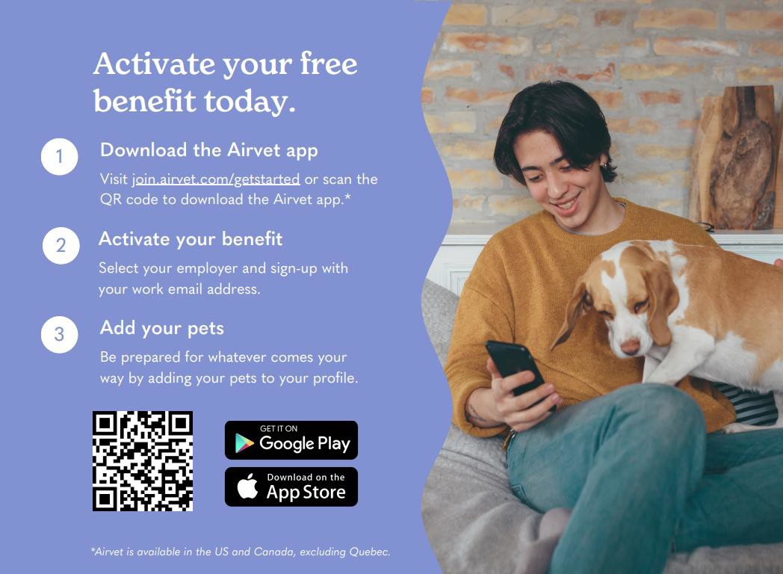
Virtual Vet Care
Airvet: 24/7 virtual vet care at no cost to you.
With Airvet, you have unlimited 24/7 on-demand access to pet care experts. Airvet is here for you for everything from urgent health concerns to routine pet care.
Available 24/7
2,000 + experts
< 2-minute response time
On-demand access
Live Chat Messaging
7,500 + 5-star reviews

Slide 30

Additional Benefits
Vacation
Vacation time granted after 90 days
80 hours of vacation years 1-4
120 hours of vacation after 5 years
160 hours of vacation after 10 years
200 hours of vacation after 25 years
401k Retirement Plan
Paid Time Off
9 paid Holidays
6 Sick Days
3 Personal Days
Eligibility: Full Time Employees aged 18 or older and have completed 90 days of service. 100% match on 6% contribution. Target date funds available, one step increase available yearly. Part-Time or seasonal age 18 employees are eligible to enroll after one year of service and a minimum of 1000 hours worked. Website: www.Vanguard.com or call 1-800-523-1188.
Tuition Reimbursement
Full-time associates of Coke Northeast who have been employed for one year or longer are eligible for tuition reimbursement assistance of up to $5,250 per calendar year to cover pre-approved expenses. Coke Northeast has partnered with Southern New Hampshire University to provide over 200-degree options to all associates and their family members.
SNHU’s Online College for America programs: $5,000 annual tuition. Total cost of degree varies, depending on speed of program completion. SNHU’s Traditional Online Degree programs: $816 per course (undergraduate) or $1,599 per course (graduate). Cost reflects 10% tuition discount. Total cost of degree varies depending on degree level and number of transfer credits.
Coke Northeast Scholarship
The Coke Northeast Scholarship program supports up to 30 exceptional college students each year. Coke Northeast will award up to three $5,000 scholarships to the highest-ranking applicants, based on the recommendations of the screening committee. Recipients will receive the $5,000 scholarship annually for two years and will have an opportunity to renew the scholarship in years three and four of their education.
Coke Northeast will award up to twenty-seven $2,000 scholarships to other applicants, based on the recommendations of the screening committee. Recipients will receive the $2,000 scholarships annually for two years and will have an opportunity to renew the scholarship in years three and four of their education.
Working Advantage
Working Advantage is an employee discount program with featured deals and brand exclusives that make a hard-earned dollar work even harder for you. Choose from categories ranging from retail, entertainment, auto, travel and more representing thousands of locations around the world. All offerings are exclusively for Coke associates. Access your employee discounts from your desktop, tablet or mobile device and start saving!
Go to: https://cokene.savings.workingadvantage.com/

Slide 31
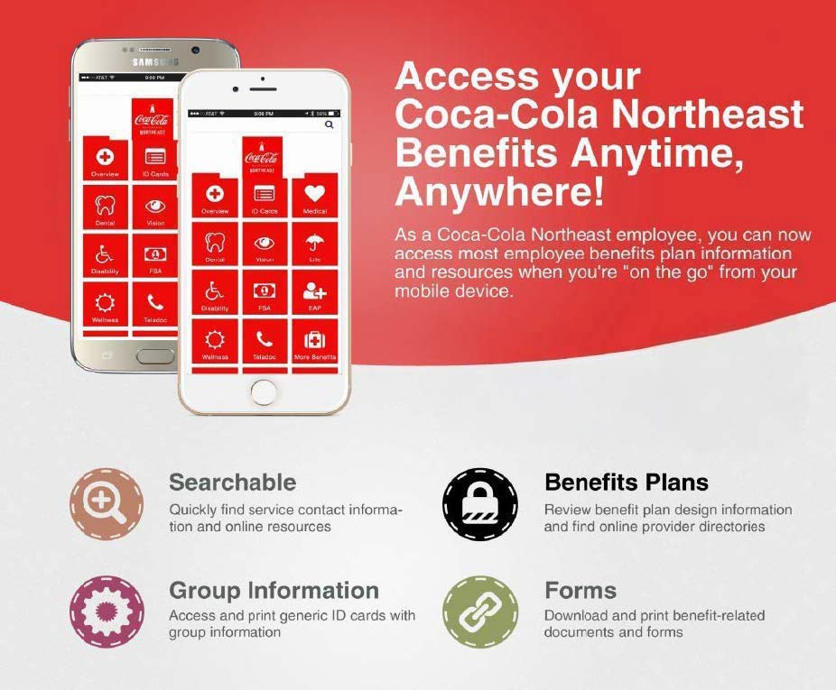
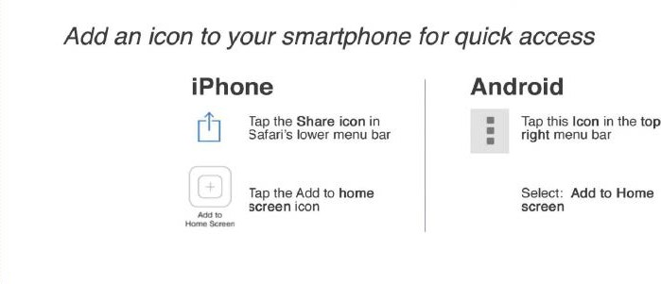
Mobile App
https://cocacola.mybenefits.life/

Slide 32


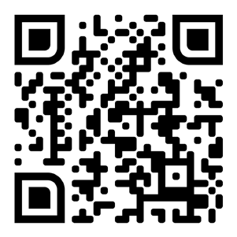

A special program for
Coca-Cola Beverages Northeast associates
Good news! As a Coca-Cola Beverages Northeast associate, you have special access to enroll in the Bank of America Preferred Rewards program and receive Gold tier benefits without the combined qualifying balance of $20,000.¹ All
you need to do is have an existing or new eligible personal Bank of America® checking account, set up your Coca-Cola Beverages Northeast payroll direct deposit into an eligible Bank of America® checking or savings account, then enroll in Preferred Rewards to start receiving your Gold tier benefits.
Scan here for more details about Preferred Rewards Gold tier benefits
Or visit https://go.bofa.com/CokeNE
This special program for associates offers:
Preferred Rewards Gold tier. After you enroll, you’ll enjoy a wide range of benefits and rewards based on the ways you save, spend and borrow with Bank of America.
Financial education. Bank of America offers a wide range of resources that can help you learn about finances and make it easier to pursue your financial goals.
Digital tools. Bank of America’s mobile and digital banking can help you bank securely from almost anywhere, plus get easy access to personalized help.2
Scan here to
ask a specialist to call you
Or visit go.bofa.com/contactme
When you use the QRC feature, certain information is collected from your mobile device for business purposes.
¹ As an employee of a company participating in the Bank of America Employee Banking and Investing Program, you are eligible to enroll in the Preferred Rewards program if you:
Have an active, eligible Bank of America personal checking account, and
Receive all or part of your payroll direct deposit from the participating company into an eligible Bank of America checking or savings account.
Employees qualify for the Gold tier of Preferred Rewards without meeting the balance requirement, and may qualify for higher tiers on the standard program terms. The standard program terms require an eligible Bank of America personal checking account and a qualifying balance of at least $20,000 for the Gold tier, $50,000 for the Platinum tier, $100,000 for the Platinum Honors tier, $1,000,000 for the Diamond tier and $10,000,000 for the Diamond Honors tier in your combined qualifying Bank of America deposit accounts (such as checking, savings, certificate of deposit) and/or your Merrill investment accounts (such as Cash Management Accounts, 529 Plans). The qualifying balance is calculated based on your average daily balance for a three calendar month period. Employee benefit plans (such as 401(k)) will not count toward the combined balance requirement. If you are no longer an employee, standard program terms apply. New employees may have to wait up to one month before they can enroll to allow for their employee status to be identified. Benefits become effective within 30 days of your enrollment, or for new accounts within 30 days of account opening, unless we indicate otherwise. Certain benefits are also available without enrolling in Preferred Rewards if you satisfy balance and other requirements. For more information, visit the Preferred Rewards section of the Personal Schedule of Fees, available at bankofamerica.com/fees.
² Mobile Banking requires that you download the Mobile Banking app and is only available for select mobile devices. Message and data rates may apply. Bank of America and the Bank of America logo are registered trademarks of Bank of America Corporation.
Bank of America, N.A., Member FDIC. Equal Housing Lender. © 2024 Bank of America Corporation. All rights reserved. FL-12-23-0184 | CEBI-630-KIT | MAP6134054 | SF00012164 | Remove by 10/2025

Slide 33

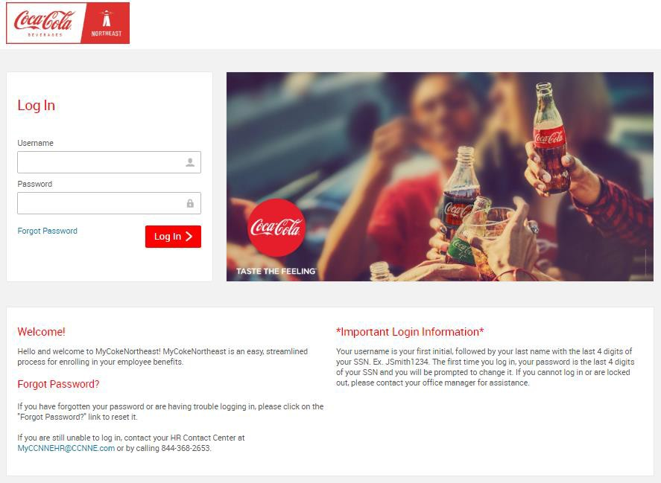
Enrollment & Next Steps
You can directly access the Benefits website by using the Web address http://cokenortheast.bswift.com. Your computer must have Google Chrome Version 19.0.1084.52 m or higher, or Microsoft edge 117.0.2045.55 or higher to use the enrollment site. Please avoid using Internet Explorer.
Log-in Information:
Username: The first initial of your first name + your last name + the last four digits of your SSN (e.g., John Smith = JSmith1234), no hyphens or apostrophes.
Password: The last four digits of your Social Security number
To reset your Password:
Click the “Forgot Password” link.
You will be prompted to enter your username or email address to begin the password reset
process. Once entered, click “Continue”.
Next, you will need to enter your date of birth. Be sure to follow the mm/dd/yyyy convention. Then
click “Continue”.
You will then be prompted to set security questions as part of the password reset method. Select
the bubble and click “Continue”.
Next, you will need to answer the following security questions. Once entered, click “Continue”.
Lastly, please enter your new password. Passwords must be 8 characters minimum and contain at least 1 number, at least 1 capital letter, and at least 1 special character.
Once you have entered your new password and verified it by entering it again, you will be taken automatically to the Home Page to access your Profile or complete an Enrollment.

Slide 34
Enrollment & Next Steps
Although the online benefits enrollment site is a secure site, and your information is encrypted during transit, it is important that you log off when you have completed your session. Click the Log Out icon in the upper right-hand corner of the enrollment site to log off. For security purposes, the system will automatically log you out if you leave your system idle for more than 30 minutes. For successful navigation of the site, do NOT use the “back” button in your internet browser, as this will automatically log you out of the site. Once you have logged in, you will be instructed to change your password. Hit Save and you will be taken to your Home Page.
To begin your enrollment from the Home Page, click on the “Start Your Enrollment” button.
Verify your Personal Information
Before beginning your enrollment, please verify the accuracy of all your personal information (e.g., address, DOB, etc.) If you need to make any changes, contact the Benefits Department (not HR Manager). Enter in all required fields with an asterisk (*).
When you are finished, please click “I agree” and “Continue” at the bottom and right-hand side of the screen.
Verify your Family Information
Please be sure to add all dependents that may be missing from the Family Information section before proceeding to the next section. To do this, click on the “Add Dependents” link. If you wish to add dependents, please note that all fields with an asterisk (*) are required. When all of your family information is accurate, read through the “Dependent Information Notice” section, check “I agree” and click “Continue.”
After verifying your personal and family information, the system will guide you through your enrollment.
Please Note: Your enrollment selections are not considered complete until you check the “Save My Enrollment”
button at the end of the enrollment and confirmation process.
Select Your Benefits
All available benefits will be displayed in the center of the screen. When a benefit selection is complete, a green check mark will be displayed next to the plan type. Throughout your enrollment, you can track your per pay period cost on the right side of your screen. Once you have made the selection on the final plan, click the “Continue” button.
Select Your Beneficiaries
After selecting your benefits, you will be prompted to designate a beneficiary or beneficiaries for any applicable
plans. Once designated, click the “Continue” button.
Review All Your Selections - Almost Finished!
You will now be directed to the final review page. Carefully review all of your benefit elections and covered dependents. Note that you may change your elections by clicking the “Edit Selection” button for any of your plan selections. The dependents you wish to have included in your coverage will be listed. You may notice that some of your elections are pended due to approval by the insurance carrier.
Once you’ve completed your review, read through the Participation agreement at the bottom of the page, click the “I agree, and I’m finished with my enrollment”, and “Complete Enrollment” buttons at the bottom and right side of the page.
Confirmation Statement
To make changes, click on the Home button to return to the Home Page, where you will see a green button for
“Change My Elections”.
It is highly recommended that you e-mail yourself a confirmation of your elections. To do so, click on the “Email” link on the New Elections page after making your election. If you don’t have an e-mail address in the system, please print out the confirmation page before you leave the site by clicking on “Print” link.
Logging Out
When you have completed any actions taken on the Benefits site, please be sure to log out by clicking the “Log Out” button on the upper right-hand corner of your browser.

Slide 35
Notices
Medicare Part D Notice
This notice explains your options for accessing prescription drug coverage if you are eligible for Medicare.
Important Notice from Coca-Cola Beverages Northeast About Your Prescription Drug Coverage and Medicare
Please read this notice carefully and keep it where you can find it. This notice has information about your current prescription drug coverage with Coca-Cola Beverages Northeast and about your options under Medicare’s prescription drug coverage. This information can help you decide whether or not you want to join a Medicare drug plan. If you are considering joining, you should compare your current coverage, including which drugs are covered at what cost, with the coverage and costs of the plans offering Medicare prescription drug coverage in your area. Information about where you can get help to make decisions about your prescription drug coverage is at the end of this notice.
There are two important things you need to know about your current coverage and Medicare’s prescription drug coverage:
Medicare prescription drug coverage became available in 2006 to everyone with Medicare. You can get this coverage if you join a Medicare Prescription Drug Plan or join a Medicare Advantage Plan (like an HMO or PPO) that offers prescription drug coverage. All Medicare drug plans provide at least a standard level of coverage set by Medicare. Some plans may also offer more coverage for a higher monthly premium.
Coca-Cola Beverages Northeast has determined that the prescription drug coverage offered by the following plans is, on average for all plan participants, expected to pay out as much as standard Medicare prescription drug coverage pays and is therefore considered Creditable Coverage.
Cigna Gold Plan
Cigna Silver Plan
Because your existing coverage is Creditable Coverage, you can keep this coverage and not pay a higher premium (a penalty) if you later decide to join a Medicare drug plan.
When Can You Join A Medicare Drug Plan?
You can join a Medicare drug plan when you first become eligible for Medicare and each year from October 15th to December 7th.
However, if you lose your current creditable prescription drug coverage, through no fault of your own, you will also be eligible for a two (2) month Special Enrollment Period (SEP) to join a Medicare drug plan.
What Happens To Your Current Coverage If You Decide to Join A Medicare Drug Plan?
If you decide to join a Medicare drug plan, your Coca-Cola Beverages Northeast coverage will not be affected. See below for more information about what happens to your current coverage if you join a Medicare drug plan.
Since the existing prescription drug coverage under the Gold and Silver plans is creditable (e.g., as good as Medicare coverage), you can retain your existing prescription drug coverage and choose not to enroll in a Part D plan; or you can enroll in a Part D plan as a supplement to, or in lieu of, your existing prescription drug coverage.
If you do decide to join a Medicare drug plan and drop your Coca-Cola Beverages Northeast prescription drug coverage, be aware that you and your dependents can only get this coverage back at open enrollment or if you experience an event that gives rise to a HIPAA Special Enrollment Right.

Slide 36
Notices
When Will You Pay A Higher Premium (Penalty) To Join A Medicare Drug Plan?
You should also know that if you drop or lose your current coverage with Coca-Cola Beverages Northeast and don’t join a Medicare drug plan within 63 continuous days after your current coverage ends, you may pay a higher premium (a penalty) to join a Medicare drug plan later.
If you go 63 continuous days or longer without creditable prescription drug coverage, your monthly premium may go up by at least 1% of the Medicare base beneficiary premium per month for every month that you did not have that coverage. For example, if you go nineteen months without creditable coverage, your premium may consistently be at least 19% higher than the Medicare base beneficiary premium. You may have to pay this higher premium (a penalty) as long as you have Medicare prescription drug coverage. In addition, you may have to wait until the following October to join.
For More Information About This Notice Or Your Current Prescription Drug Coverage…
Contact the person listed below for further information. NOTE: You’ll get this notice each year. You will also get it before the next period you can join a Medicare drug plan, and if this coverage through Coca-Cola Beverages Northeast changes. You also may request a copy of this notice at any time.
For More Information About Your Options Under Medicare Prescription Drug Coverage …
More detailed information about Medicare plans that offer prescription drug coverage is in the “Medicare & You” handbook. You’ll get a copy of the handbook in the mail every year from Medicare. You may also be contacted directly by Medicare drug plans.
For more information about Medicare prescription drug coverage:
Visit medicare.gov.
Call your State Health Insurance Assistance Program (see the inside back cover of your copy of the “Medicare & You” handbook for their telephone number) for personalized help.
Call 800-MEDICARE (800-633-4227). TTY users should call 877-486-2048.
If you have limited income and resources, extra help paying for Medicare prescription drug coverage is available. For information about this extra help, visit Social Security on the web at socialsecurity.gov, or call them at 800-772-1213 (TTY 800-325-0778).
Remember: Keep this Creditable Coverage notice. If you decide to join one of the Medicare drug plans, you may be required to provide a copy of this notice when you join to show whether or not you have maintained creditable coverage and, therefore, whether or not you are required to pay a higher premium (a penalty).
Date: 10/15/2026
Name of Entity/Sender: Coca-Cola Beverages Northeast
Contact-Position/Office: John Polcari, Director of Total Rewards
Address: 1 Executive Park Drive, Bedford, NH 03110
Phone Number: 603-413-7411

Slide 37
Notices
Women’s Health and Cancer Rights Act
This notice describes benefits available to people who have had or will have a mastectomy.
If you have had or are going to have a mastectomy, you may be entitled to certain benefits under the Women’s Health and Cancer Rights Act of 1998 (WHCRA). For individuals receiving mastectomy-related benefits, coverage will be provided in a manner determined in consultation with the attending physician and the patient, for:
All stages of reconstruction of the breast on which the mastectomy was performed;
Surgery and reconstruction of the other breast to produce a symmetrical appearance;
Prostheses; and
Treatment of physical complications of the mastectomy, including lymphedema.
These benefits will be provided subject to the same deductibles and coinsurance applicable to other medical and surgical benefits provided under this plan. If you would like more information on WHCRA benefits, call your plan administrator at 603-413-7411.
Newborns’ and Mothers’ Health Protection Act
This notice explains the rights of mothers and newborns to stay in the hospital 48–96 hours after delivery.
Group health plans and health insurance issuers generally may not, under Federal law, restrict benefits for any hospital length of stay in connection with childbirth for the mother or newborn child to less than 48 hours following a vaginal delivery, or less than 96 hours following a cesarean section. However, Federal law generally does not prohibit the mother’s or newborn’s attending provider, after consulting with the mother, from discharging the mother or her newborn earlier than 48 hours (or 96 hours as applicable). In any case, plans and issuers may not, under Federal law, require that a provider obtain authorization from the plan or the insurance issuer for prescribing a length of stay not in excess of 48 hours (or 96 hours). If you would like more information on maternity benefits, call your plan administrator at 603-413-7411.
HIPAA Notice of Special Enrollment Rights
This notice explains when you and/or your dependents can enroll in medical coverage outside of the annual open enrollment period.
If you decline enrollment in Coca-Cola Beverages Northeast’s health plan for you or your dependents (including your spouse) because of other health insurance or group health plan coverage, you or your dependents may be able to enroll in Coca-Cola Beverages Northeast’s health plan without waiting for the next open enrollment period if you:
Lose other health insurance or group health plan coverage. You must request enrollment within 30 days after the loss of other coverage.
Gain a new dependent as a result of marriage, birth, adoption, or placement for adoption. You must request health plan enrollment within 30 days after the marriage, birth, adoption, or placement for adoption.
Lose Medicaid or Children’s Health Insurance Program (CHIP) coverage because you are no longer eligible. You must request medical plan enrollment within 60 days after the loss of such coverage.
If you request a change due to a special enrollment event within the 30-day timeframe, coverage will be effective the date of birth, adoption or placement for adoption. For all other events, coverage will be effective the first of the month following your request for enrollment. In addition, you may enroll in Coca-Cola Beverages Northeast’s health plan if you become eligible for a state premium assistance program under Medicaid or CHIP. You must request enrollment within 60 days after you gain eligibility for medical plan coverage. If you request this change, coverage will be effective the first of the month following your request for enrollment. Specific restrictions may apply, depending on federal and state law.
Note: If your dependent becomes eligible for a special enrollment right, you may add the dependent to your current coverage or change to another health plan.

Slide 38
Notices
Availability of Privacy Practices Notice
This notice explains how to access the HIPAA Notice of Privacy Practices, which describes how health information about you may be used and disclosed.
We maintain the HIPAA Notice of Privacy Practices for Coca-Cola Beverages Northeast describing how health information about you may be used and disclosed. You may obtain a copy of the Notice of Privacy Practices by contacting your plan administrator at 603-413-7411.
ACA Disclaimer
This notice explains how insurance offered by Coca-Cola Beverages Northeast affects your eligibility for premium subsidies through the ACA Exchange.
This offer of coverage may disqualify you from receiving government subsidies for an Exchange plan even if you choose not to enroll. To be subsidy eligible you would have to establish that this offer is unaffordable for you, meaning that the required contribution for employee only coverage under our base plan exceeds 9.96% of your modified adjusted household income in 2026 (10.22% in 2027).
The ‘No Surprises’ Rules
This notice explains rules that protect you from unexpected large medical bills and limits on out-of-network charges for certain services.
The “No Surprises” rules protect you from surprise medical bills in situations where you can’t easily choose a provider who’s in your health plan network. This is especially common in an emergency situation, when you may get care from out-of-network providers. Out-of-network providers or emergency facilities may ask you to sign a notice and consent form before providing certain services after you’re no longer in need of emergency care. These are called “post-stabilization services.” You shouldn’t get this notice and consent form if you’re getting emergency services other than post-stabilization services. You may also be asked to sign a notice and consent form if you schedule certain non-emergency services with an out-of-network provider at an in-network hospital or ambulatory surgical center.
The notice and consent form informs you about your protections from unexpected medical bills, gives you the option to give up those protections and pay more for out-of-network care, and provides an estimate of what your out-of-network care might cost. You aren’t required to sign the form and shouldn’t sign the form if you didn’t have a choice of health care provider or facility before scheduling care. If you don’t sign, you may have to reschedule your care with a provider or facility in your health plan’s network.
View a sample notice and consent form (PDF).
This applies to you if you’re a participant, beneficiary, enrollee, or covered individual in a group health plan or group or individual health insurance coverage, including a Federal Employees Health Benefits (FEHB) plan.

Slide 39
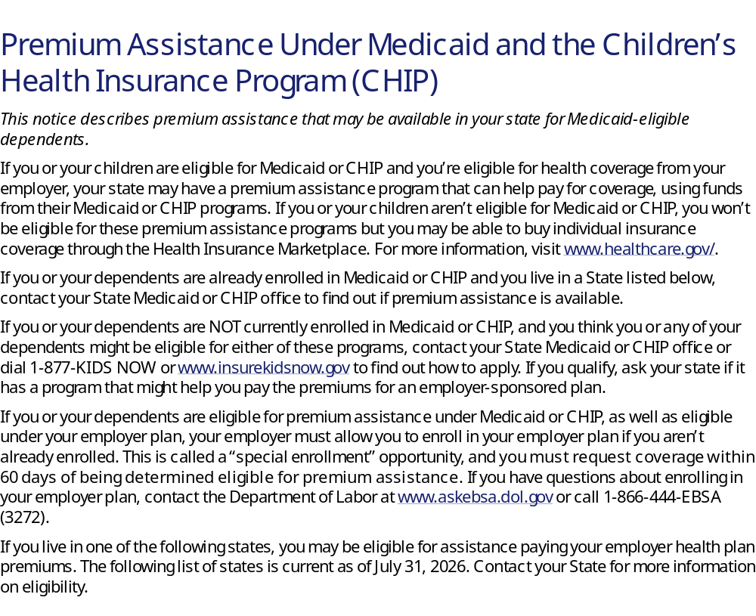
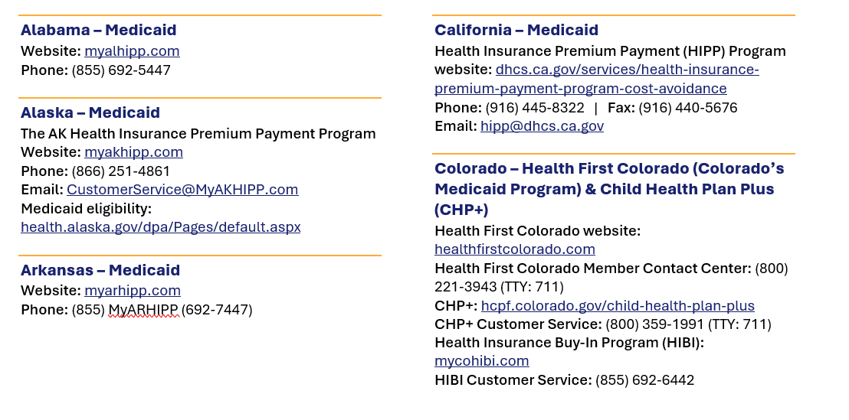
Notices

Slide 40
Florida – Medicaid
Website: flmedicaidtplrecovery.com/flmedicaidtplrecovery.com/hipp
Phone: (877) 357-3268
Georgia – Medicaid
GA HIPP Website: medicaid.georgia.gov/health-insurance-premium-payment-program-hipp
Phone: (678) 564-1162, press 1
GA CHIPRA Website: medicaid.georgia.gov/programs/third-party-liability/childrens-health-insurance-program-reauthorization-act-2009-chipra
Phone: (678) 564-1162, press 2
Illinois – Medicaid
Illinois Medicaid Premium Assistance Information
Medicaid application website: abe.illinois.gov
HIPP Hotline Number: (217) 524-8268
HIPP Email: mhfs.boc.hipp@illinois.gov
Indiana – Medicaid
Health Insurance Premium Payment Program
All other Medicaid
Website: in.gov/medicaid
Website: in.gov/fssa/dfr
Family and Social Services Administration
Phone: (800) 403-0864
Member Services phone: (800) 457-4584
Iowa – Medicaid and CHIP (Hawki)
Medicaid website: hhs.iowa.gov/programs/welcome-iowa-medicaid
Medicaid phone: (800) 338-8366
Hawki website: hhs.iowa.gov/programs/welcome-iowa-medicaid/iowa-health-link/hawki
Hawki Phone: (800) 257-8563
HIPP website: hhs.iowa.gov/programs/welcome-iowa-medicaid/fee-service/hipp
HIPP Phone: (888) 346-9562
Kansas – Medicaid
Website: kancare.ks.gov
Phone: (800) 792-4884
HIPP Phone: (800) 967-4660
Kentucky – Medicaid
Kentucky Integrated Health Insurance Premium Payment Program (KI-HIPP) website: chfs.ky.gov/agencies/dms/member/Pages/kihipp.aspx
Phone: (855) 459-6328
Email: KIHIPP.PROGRAM@ky.gov
KCHIP website: kynect.ky.gov
Phone: (877) 524-4718
Medicaid website: chfs.ky.gov/agencies/dms
Louisiana – Medicaid
Louisiana Medicaid website: ldh.la.gov/healthy-louisiana
Medicaid Customer Service Line: (888) 342-6207
Louisiana Medicaid email: healthy@la.gov
Louisiana Health Insurance Premium Program (LaHIPP) Website: ldh.la.gov/lahipp
LaHIPP phone: (877) 697-6703
LaHIPP email: La.HIPP@la.gov
LaHIPP fax: (888) 716-9787
LaHIPP mailing address: 100 Crescent Centre Parkway, Suite 1000, Tucker, GA 30084
Maine – Medicaid
Enrollment website: mymaineconnection.gov/benefits
Phone: (800) 442-6003 (TTY: 711)
Private Health Insurance Premium webpage: maine.gov/dhhs/ofi/applications-forms
Phone: (800) 977-6740 (TTY: 711)
Massachusetts – Medicaid and CHIP
Website: mass.gov/masshealth/pa
Phone: (800) 862-4840 (TTY: 711)
Email: masspremassistance@accenture.com
Minnesota – Medicaid
Website: mn.gov/dhs/health-care-coverage/
Phone: (800) 657-3672
Missouri – Medicaid
Website: https://dss.mo.gov/healthcare/apply
Phone: (573) 751-2005
Montana – Medicaid
Website: dphhs.mt.gov/MontanaHealthcarePrograms/HIPP
Phone: (800) 694-3084
Email: HHSHIPPProgram@mt.gov

Slide 41
Nebraska – Medicaid
Website: accessnebraska.ne.gov
Phone: (855) 632-7633
Lincoln: (402) 473-7000
Omaha: (402) 595-1178
Nevada – Medicaid
Medicaid website: dhcfp.nv.gov
Medicaid phone: (800) 992-0900
New Hampshire – Medicaid
Website: dhhs.nh.gov/programs-services/medicaid/health-insurance-premium-program
Phone: (603) 271-5218
Toll free number for the HIPP program: (800) 852-3345, ext. 15218
Email: DHHS.ThirdPartyLiabi@dhhs.nh.gov
New Jersey – Medicaid and CHIP
Website: nj.gov/humanservices/dmahs/individuals-families/familycare
Phone: (800) 356-1561
CHIP Premium Assistance Phone: (609) 631-2392
CHIP phone: (800) 701-0710 (TTY: 711)
New York – Medicaid
Website: health.ny.gov/health_care/medicaid
Phone: (800) 541-2831
North Carolina – Medicaid
Website: medicaid.ncdhhs.gov
Phone: (919) 855-4100
North Dakota – Medicaid
Website: hhs.nd.gov/healthcare
Phone: (866) 614-6005
Oklahoma – Medicaid and CHIP
Website: insureoklahoma.org
Phone: (888) 365-3742
Oregon – Medicaid
Website: healthcare.oregon.gov
Phone: (800) 699-9075
Pennsylvania – Medicaid and CHIP
Website: pa.gov/en/services/dhs/apply-for-medicaid-health-insurance-premium-payment-program-hipp.html
Phone: (800) 692-7462
CHIP website: dhs.pa.gov/CHIP/Pages/CHIP.aspx
CHIP phone: (800) 986-KIDS (5437)
Rhode Island – Medicaid and CHIP
Website: eohhs.ri.gov
Phone: (855) 697-4347 or (401) 462-0311 (Direct RIte Share Line)
South Carolina – Medicaid
Website: scdhhs.gov
Phone: (888) 549-0820
South Dakota – Medicaid
Website: dss.sd.gov
Phone: (888) 828-0059
Texas – Medicaid
Website: hhs.texas.gov/services/financial/health-insurance-premium-payment-hipp-program
Phone: (800) 440-0493
Utah – Medicaid and CHIP
Utah’s Premium Partnership for Health Insurance (UPP) website: medicaid.utah.gov/upp
Phone: (888) 222-2542
Email: upp@utah.gov
Adult Expansion website: medicaid.utah.gov/expansion
Utah Medicaid Buyout Program website: medicaid.utah.gov/buyout-program
CHIP website: chip.utah.gov
Vermont – Medicaid
Website: dvha.vermont.gov/members/medicaid/hipp-program
Phone: (800) 250-8427
Virginia – Medicaid and CHIP
Website: coverva.dmas.virginia.gov/learn/premium-assistance/famis-select
Website: coverva.dmas.virginia.gov/learn/premium-assistance/health-insurance-premium-payment-hipp-programs
Medicaid/CHIP phone: (800) 432-5924

Slide 42
Washington – Medicaid
Website: hca.wa.gov
Phone: (800) 562-3022
West Virginia – Medicaid and CHIP
Website: bms.wv.gov
Website: mywvhipp.com
Medicaid phone: (304) 558-1700
CHIP toll-free phone: (855) MyWVHIPP (699-8447)
Wisconsin – Medicaid and CHIP
Website: dhs.wisconsin.gov/badgercareplus/p-10095.htm
Phone: (800) 362-3002
Wyoming – Medicaid
Website: health.wyo.gov/healthcarefin/medicaid/programs-and-eligibility/
Phone: (800) 251-1269
To see if any other states have added a premium assistance program since July 31, 2026, or for more information on special enrollment rights, contact either:
U.S. Department of Labor
Employee Benefits Security Administration
www.dol.gov/agencies/ebsa
1-866-444-EBSA (3272)
U.S. Department of Health and Human Services Centers for Medicare & Medicaid Services
www.cms.hhs.gov
1-877-267-2323, Menu Option 4, Ext. 61565
Paperwork Reduction Act Statement
According to the Paperwork Reduction Act of 1995 (Pub. L. 104-13) (PRA), no persons are required to respond to a collection of information unless such collection displays a valid Office of Management and Budget (OMB) control number. The Department notes that a Federal agency cannot conduct or sponsor a collection of information unless it is approved by OMB under the PRA, and displays a currently valid OMB control number, and the public is not required to respond to a collection of information unless it displays a currently valid OMB control number. See 44 U.S.C. 3507. Also, notwithstanding any other provisions of law, no person shall be subject to penalty for failing to comply with a collection of information if the collection of information does not display a currently valid OMB control number. See 44 U.S.C. 3512.
The public reporting burden for this collection of information is estimated to average approximately seven minutes per respondent. Interested parties are encouraged to send comments regarding the burden estimate or any other aspect of this collection of information, including suggestions for reducing this burden, to the U.S. Department of Labor, Employee Benefits Security Administration, Office of Policy and Research, Attention: PRA Clearance Officer, 200 Constitution Avenue, N.W., Room N-5718, Washington, DC 20210 or email ebsa.opr@dol.gov and reference the OMB Control Number 1210-0137.

Slide 43
Notes

Slide 44



This document summarizes the benefit plans offered to eligible employees of Coca-Cola Beverages Northeast. Every effort has been made to ensure that the information is clear and accurate. However, this is intended as general summary and you should refer to the Employee Handbook, the contracts or official Plan Documents (also referred to as Subscriber Certificates or Summary Plan Descriptions [SPDs]) or contact your Human Resources Representative for more detailed information about the benefits. In the event of any conflict or inconsistencies between the information in this document and the handbook, the contracts or official SPDs, the handbook, the contracts or official SPDs will govern. Coca-Cola Beverages Northeast reserves the right to change or discontinue these benefits, in whole or in part, at any time. This document does not constitute an employment agreement between you and Coca-Cola Beverages Northeast.

